Slide 1
Deterministic Finite Automaton (DFA)
CSC3113: Theory of Computation
2
1
Summer 2020-2021
Dr. Hossain Md Shakhawat, Assistant Professor,
Department of Computer Science, Faculty of Science & Technology.
shakhawat@aiub.edu

Slide 2
Finite Automata (FA).
Example and Simulation of FA.
Finite state machine models.
Definition
Deterministic Finite Automata (all with examples)
Terminologies & State Diagram
Formal Mathematical Definition
Formal Computational Definition

Slide 3
Understand, learn & practice with example
Finite Automata (FA)
FA Machine Models
Finite State Machine
Deterministic Finite Automata (DFA)
Formal Definition of DFA
Computational Definition of DFA

Slide 4
All outcome are represented with examples
Know all the components of a finite state machine.
Learn the terminologies, conditions, and representation of the machine models.
How to define a machine model, along with its characteristics, using mathematical structure.
How to define the computation perform by the machine model using mathematical structure.
Understand the mathematical model for DFA
Students will be able to
Formally define a given DFA machine model
Run the machine for given input and determine if it is accepted or rejected.

Slide 5
Automata Theory
Automata comes from the Greek word (Αυτόματα) which means that something is doing something by itself.
Automata deals with the study of abstract (mathematical model) machines or systems (definition and properties) and the computational problems (defined in terms of formal languages) that can be solved (recognized) using these machines.
Automata are used as theoretical models for computing machines (input, process, output),
An automaton can be a finite representation of a formal language that may be an infinite set (language theory). Formal languages are the preferred mode of specification (input) for any problem that must be computed (processed).
These abstract computing machines are used for proofs about computability (solvability).
Such models include –
finite automaton, used in text processing, compilers, and hardware design
Context-free grammar, used in programming languages and artificial intelligence

Slide 6
Finite State machine or finite Automata
Finite Automata(FA) is the simplest abstract machine/computation model with extremely limited memory to recognize patterns. Also called finite state machine (FSM) or finite state automata (FSA).
FA can be exactly in one state at a time. It can change from one state to another in response to the given input based on the rules; the change from one state to another is called a transition. An FA is defined by a list of its states, its initial state, and the inputs that trigger each transition.
The FA has five elements or tuple { Q, Σ, q_{o}, F, δ }:
Q : Finite set of states
Σ : set of Input Symbols called alphabet
q_{o} : Initial or starting state, q_{o} ∈ Q
F : set of Final States F ⊆ Q, also called accept states
δ : Transition Function, defined as Q × Σ → Q
Two types of FA: Deterministic FA (DFA) and non-deterministic FA (NFA)

Slide 7
Finite Automata
We will use several different computational models
Example of models with an extremely limited amount of memory: various household appliances such as dishwashers, vending machines, and electronic thermostats, as well as parts of digital watches and calculators
The design of such devices requires keeping the methodology and terminology of finite automata in mind
FA has less computational power than some other models of computation such as the Turing machine. There are tasks that a Turing machine can do but an FA cannot because of its limited memory.
An FA has the same computational power as a Turing machine that is restricted such that its head may only perform "read" operations, and always has to move from left to right

Slide 8
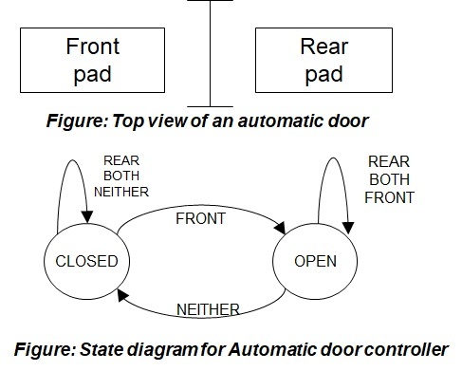
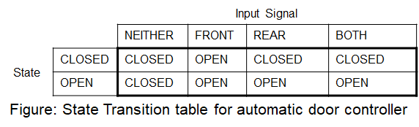
Automatic Door
Automatic doors swing open when sensing that a person is approaching.
An automatic door has a pad in front to detect the presence of a person about to walk through the doorway.
Another pad is located to the rear of the doorway so that –
The controller can hold the door long enough for the person to pass all the way through.
The door does not strike someone standing behind it as it opens.
An Example

Slide 9
Simulation – Automatic Door
Input Example:
Initial State: CLOSED
Input Signal Sequence: FRONT, REAR, NEITHER, FRONT, BOTH, NEITHER, REAR, NEITHER.
Present State:
CLOSED
OPEN
Input Signal:
REAR
FRONT
NEITHER
BOTH
REAR
REAR
BOTH
BOTH
NEITHER
FRONT
FRONT
CLOSED
OPEN
Front
pad
Rear
pad
NEITHER
Figure: Top view of an automatic door
Figure: State diagram for Automatic door controller

Slide 10
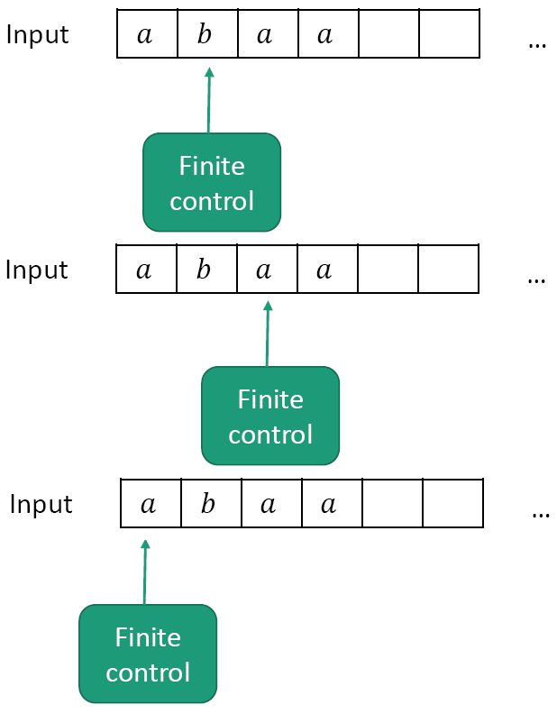
Machine Models
Computation is the processing of information by the unlimited application of a finite set of operations or rules.
Abstraction: We don’t care how the control is implemented.
We just require it to –
read a given input string
have a finite number of states, and
transition between states using fixed rules.
Finite State Machine

Slide 11
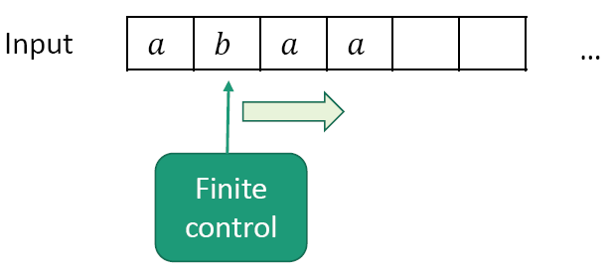
Machine Model
Finite Automata (FA)
Machine with a finite amount of unstructured memory.
Control scans a given input string only once (from some language) left-to-right, one by one.
Can check/match simple patterns (by transiting from state to state based on some given rules)
Can’t perform unlimited counting
Useful for modeling chips, simple control systems, adventure games…

Slide 12
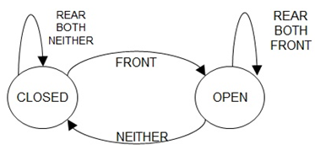
Finite Automata – definition
A finite automata has several parts –
It has a precise set of inputs (Language)
Example: FRONT, REAR, BOTH, NEITHER.
Set of states
Example: the auto door has CLOSED and OPEN states.
Initial (start) state must be defined
Example: CLOSED in the door example.
Rules for going from one state to another based on input Also known as transition rules.
Example: if door is in CLOSED state and [rule] someone is only on the front pad, then the door will go to OPEN state based on input, FRONT.
May have one or more state(s) as goal to reach from start state. Also known as set of final/accept states
Example: CLOSED as the last input signal is NIETHER in the door example.
Page 35 (1.5)

Slide 13
Meaning of the word deterministic
In mathematics, computer science and physics, a deterministic system is a system in which no randomness is involved in the development of future states of the system.
A deterministic model will thus always produce the same output from a given starting condition or initial state.

Slide 14
Deterministic Finite Automata (DFA)
A Finite Automata(FA) is said DFA, if there is single resultant state for an input symbol. In DFA every next step is pre-determined by some rules (that’s why it’s called deterministic).
DFA is a 5 tuples {Q, Σ, q_{o}, F, δ} where,
Q : is a finite set (nonempty) of all states
Σ : is finite set (nonempty) of input symbols called alphabet. (Symbols which machine takes as input )
q_{o} : is the starting or initial state, q_{o} ∈ Q
F : is the nonempty set of final (accept) states, F ⊆ Q
δ : is the transition function, defined as Q × Σ → Q (takes a state from Q and an input from Σ then returns a state of Q)
If A is the set of all strings that a machine M accepts, we say that A is the language of machine M and write L(M)=A, M recognizes A or M accepts A.
In DFA, for a particular input char, the machine goes to one state only. A transition function is defined on every state for every input symbol. Null (or ε) move is not allowed in DFA. Meaning, it can’t change state without any input

Slide 15
Deterministic Finite Automata (DFA)
Every step of a computation follows in a unique way from the preceding step (deterministic computation).
When the machine is in a given state and reads the next input symbol, we know the next state will be – it is determined.
The transition rules are of the form :
Each state must have exactly one transition for each input from the input set to any individual state (including itself).
If there are n number of inputs, then each state must have exactly n transitions to any states (including itself).
There must be exactly one start state to start the transition and one or more final states to finish the transition.
DFA accepts regular languages. In other words, a language is regular if a DFA accepts it. FAs are usually taught using languages made up of binary strings that follow a particular pattern. Both regular and non-regular languages can be made out of binary strings

Slide 16
NON-Deterministic Finite Automata (NFA)
A Finite Automata(FA) is said NFA, if there is more than one possible transition from one state on the same input symbol. Here every next step may have zero or more number of choices to move on.
A NFA is a 5 tuples {Q, Σ, q_{o}, F, δ} where,
Q : is a finite set (nonempty) of all states
Σ : is finite set (nonempty) of input symbols called alphabet. (Symbols which machine takes as input )
q_{o} : is the starting or initial state, q_{o} ∈ Q
F : is the nonempty set of final (accept) states, F ⊆ Q
δ : is the transition function, defined as Q × Σ → 2^{Q} (takes a state from Q and an input from Σ then returns a subset of Q)

Slide 17
DFA VS NFA
 | DFA | NFA
1 | DFA stands for Deterministic Finite Automata | NFA stands for Nondeterministic Finite Automata
2 | For each symbolic representation of the alphabet, there is only one state transition in DFA | No need to specify how does the NFA react according to some symbol
3 | DFA cannot use Empty String transition | NFA can use Empty String transition
4 | DFA can be understood as one machine. | NFA can be understood as multiple little machines computing at the same time.
5 | In DFA, the next possible state is distinctly set | In NFA, each pair of state and input symbol can have many possible next states
6 | DFA is more difficult to construct | NFA is easier to construct

Slide 18
DFA VS NFA
 | DFA | NFA
7 | DFA rejects the string in case it terminates in a state that is different from the accepting state. | NFA rejects the string in the event of all branches dying or refusing the string.
8 | Less time needed for executing an input string | More time needed for executing an input string
9 | All DFA are NFA. | Not all NFA are DFA.
10 | DFA requires more space. | NFA requires less space then DFA.
11. | Dead state may be required. | Dead state is not required.
12. | Transition δ: QxΣ -> Q means next possible state belongs to Q. | Transition δ: QxΣ -> 2^Q means next possible state belongs to power set of Q.

Slide 19
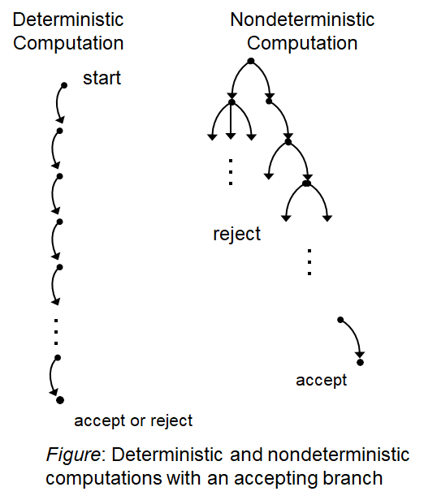
Tree representation of DFA VS NFA

Slide 20
Terminologies
Deterministic Finite Automata (DFA)
State Diagram
0
1
1, 0
q₁
q₂
q₃
1
0
3 states, labeled q₁, q₂, and q₃.
The start state is q₁, indicated by the arrow pointing at it from no where.
The accept state, q₂, is the one with a double circle.
The arrow going from one state to another (or to itself [loop]) are called transitions.
The symbol(s) along the transition is called label.
Each label is from input set {0, 1}.
From each state there are exactly one transition for each input 0 and 1.
M₁ works as follows –
The automaton receives the symbols from the input string one by one from left to right.
After reading each symbol, M1 moves from one state to another along the transition that has the symbol as its label.
When it reads the last symbol, M1 produces the output.
The output is ACCEPT if M1 is now in an accept state and REJECT if it is not.

Slide 21
Simulation – How it works?
0
1
1
0
q₁
q₂
q₃
ε
1101
1101
101
1
01
Figure: Finite Automaton M₁.
0,1
After feeding the input string 1101 to the above machine, the processing proceeds as follows –
Start in state q₁;
Read 1, follow transition from q₁ to q₂;
Read 1, follow transition from q₂ to q₂;
Read 0, follow transition from q₂ to q₃;
Read 1, follow transition from q₃ to q₂;
ACCEPT, as the machine M₁ is in an accept state q₂ at the end of the input string.

Slide 22
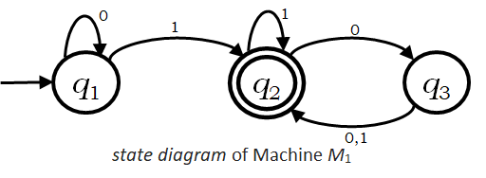
Formal Definition for Machine M₁
Example
M₁ = (Q, Σ, δ, q₀, F), where –
Q = {q₁ , q₂ , q₃} ,
Σ = {0, 1},
q₀ = q₁ ,
F = {q₂},
δ is describe as –
δ | 0 | 1
q₁ | q₁ | q₂
q₂ | q₃ | q₂
q₃ | q₂ | q₂
δ(q₁,0) = q₁, δ(q₁,1) = q₂,
δ(q₂,0) = q₃, δ(q₂,1) = q₂,
δ(q₃,0) = q₂, δ(q₃,1) = q₂.
OR
Transition Function
Transition Table

Slide 23
Formal Definition of DFA Computation
Now we formalize the Deterministic Finite Automaton’s computation, mathematically.
Let,
M = (Q, Σ, δ, q₀, F) be a DFA,
w = w₁w₂…w_{n} ∈ Σ* (a string over the alphabet Σ), where each w_{i} ∈ Σ.
Then M accepts w if a sequence of states r₀,r₁,…,r_{n} exists in Q with the following three conditions –
r₀=q₀,
δ(r_{i}, w_{i+1}) = r_{i+1}, for i = 0, 1, 2, … , n-1, and
r_{n} ∈F.
M recognizes language L if L = {w : M accepts w}.

Slide 24
Simulation – DFA Computation
0
1
1
0
q₁
q₂
q₃
ε
1101
1101
101
1
01
Figure: Finite Automaton M₁.
0,1
M=(Q, Σ, δ, q₀, F)=({q₁ , q₂ , q₃}, {0, 1}, δ , q₁, {q₂}) and δ = {δ(q₁,0)=q₁, δ(q₁,1)=q₂, δ(q₂,0)=q₃, δ(q₂,1)=q₂, δ(q₃,0)=q₂, δ(q₃,1)=q₂}
Input string w = w₁w₂w₃w₄ = 1101 to M₁ gives a sequence of states r₀,r₁,r₂,r₃,r₄ in the following computation (here n = 4) –
Start in state r₀ = q₁; → r₀=q₀,
δ(r₀,w₁) = δ(q₁,1) = q₂ = r₁; → δ(r_{i}, w_{i+1}) = r_{i+1}, for i = 0, 1, 2, … , n-1,
δ(r₁,w₂) = δ(q₂,1) = q₂ = r₂; → δ(r_{i}, w_{i+1}) = r_{i+1}, for i = 0, 1, 2, … , n-1,
δ(r₂,w₃) = δ(q₂,0) = q₃ = r₃; → δ(r_{i}, w_{i+1}) = r_{i+1}, for i = 0, 1, 2, … , n-1,
δ(r₃,w₄) = δ(q₃,1) = q₂ = r₄; → r_{n} ∈F.
Accept, as the machine M₁ is in an accept state q₂ at the end of the input string.
M₁ recognizes language L if L = {w : M₁ accepts w}.

Slide 25
Practice the exercises
Introduction to Theory of Computation, Sipser, (3rd ed),
DFA; All Exercises;
Elements of the Theory of Computation, Papadimitriou (2nd ed), Chapter 1.

